Slide 1



Smart cities-towards a wider understanding via the case of Greece
Maria bottis, professor of Information law, ionian university

Slide 2
We do live in a smart time
IT is ubiquitous – applications rule our lives – smart phones, cars, appliances, ….
Smart is what we consider as a top quality for our well being and happiness
Moving from a smart phone to a smart city - a city that combines many smart applications in possibly every services sector

Slide 3
a series of definitions for a smart city
Initially, a smart city was a city where Information and Communication technologies…
(ICT=unified communications and the integration of telecommunications -telephone lines and wireless signals-and computers, as well as necessary enterprise software, middleware, storage and audiovisual, that enable users to access, store, transmit, understand and manipulate information)
…supported social participation, closing the digital divide and offering greater access to public information and services
(Anthopoulos & Fitisalis 2013)

Slide 4
The smart city developed into urban domains of business opportunities and ubiquitous technologies
From technology to socioeconomic governance and social participation towards sustainability of the city, quality of life and well-being of the citizens
ICT used for management, governance, administration and communication with citizens
(Bakici, Almirall & Wareham, 2013)
Examples: transport, traffic, security surveillance, public internet hot spots, electronic government e.tc.
Aims: increase of the efficiency and profitability from resources, social and economic development, social capital e.tc.

Slide 5
Words, words, words
Intelligent city/Information city, digital city, ubiquitous city, creative city, green city, clever city/smart city/instrumented city/interconnected city/knowledge-based city/broadband city/mobile-ambient city/eco-city/web-virtual city/learning city/sustainable city
We have many classifications proposed here

Slide 6
Too many terms-meaning?
The connection to the above aims to the citizen’s general happiness and well-being is not always stressed as such in the literature
Perhaps authors believe this is automatic?

Slide 7
Two dominant interpretative models
a technocentric view (TV) and a human-centred (H-CP) perspective
TV= “smart city” as a depoliticised matter of merely applying ICT technologies to urban challenges to create datafied conditions for decision making, efficiency and innovation
TV=mainly corporate driven
H-CP= views technology as a tool to facilitate broader goals: the empowerment of citizens through participation and investment in their human and social capital becomes crucial to facilitating their use of the city as a laboratory for urban change
H-CP=led by (in particular European) universities and connected to the needs of governments
(Alina Wernick/Emeline Banzuzi /Alexander Mörelius-Wulff, Internet Policy Review, 2023)

Slide 8
Criticisms
Widening the digiTal divide=smart city is smart for a techno-smart citizen
All the rest remain alienated from the benefits offered
Widening discrimination and segregation within the city
Or: what is the wiser use of resources?

Slide 9
Greece
The “Smart Cities” program in Greece, launched by the Greek Ministry of Digital Governance in 2021, entered its second phase and opened to 315 municipalities in July.
Municipalities with a population of up to 100,000 residents are eligible to submit their digital transformation proposals between July 1 – October 31.
Budgeted at some 230 million euros, the Smart Cities program’s second phase is funded by the European Regional Development Fund. Eligible municipalities can receive funds between 210,000 – 2,77 million euros depending on their population.
The aim of the program is to upgrade everyday life for citizens and local communities through digital projects that best meet the priorities of each municipality, through a list of projects divided into seven categories

Slide 10
categories
Sustainable mobility
Energy saving
Reduction of energy footprint for municipal buildings
Improvement of services for citizens and businesses
Improvement of quality of life
Strengthening local democracy, consultation and transparency
Protection against cyber attacks and enhancement of digital infrastructure

Slide 11
actions
Municipalities will be called to select among 38 actions that best meet their needs. These include:
a smart parking system
smart stops for public transportation
a smart system ensuring access for people with mobility problems
smart and disabled-friendly pedestrian crossings
a smart city / municipal guide offering info on local businesses
management of indoor and outdoor sports, culture and entertainment venues
electronic ticket management for sports and cultural events
a smart warning system for extreme natural phenomena (floods, fire, earthquakes e.tc.)
the digitization of local cultural heritage
the selection of a digital twin city.

Slide 12
GREEK CITY OF TRIKALA AS A SMART CITY
Trikala sits at the heart of the Greek mainland
Region of Thessaly
Greece’s “first digital city”
‘Smart Trikala’= a wide range of digital solutions
The city has performed highly in terms of innovation results

Slide 13
E-Trikala….
e-trikala=offers a range of applications for the citizens-strengthens the participation of the citizens in critical decisions-free access to internet—a wide set of electronic services
telepronoia=telematics to support the elderly, disabled, people with chronic diseases, vulnerable citizens e.tc.
ISIEMD=smart system of smart homes towards independent living and personal care of the elderly with dementia
Tele-care services to patients with chronic diseases for free via the Telecare Center with mobile tele-cardiograph, tele-blood pressure monitor and others---sends data to the competent doctor of Larissa’s University Hospital (which is close).
e-dialogue (finalist project for the European e-Government awards 2009 in Malmo)
Trikala tourism-services for the tourists
Urban CIS35=GIS as a digital city guide, accessible vie internet and mobiles

Slide 14
E-Trikala….
smart transport=informs on traffic/manages traffic data/bus digital data in stops / parking spots information
free access to the internet/transactions with the city possible
First city in the world to offer a self driven bus-2015-2016, within the city, in real transport conditions.-A pilot program with 7 european cities-City Mobil 2.
6 buses-for 10 people-controlled by distance
electronic submission of complaints by the citizens (DIMOSTHENES)
e-trikala is a private company of the City. Collaboration towards e-trikala=Universities and industry plus a task force.
Also on the way-smart parking (45 places for disabled/monitors free spaces in the roads/pay via phone)
Smart lighting-24 new LED lamps monitoring traffic and lowers cost
-an experiment with sensor-equipped streetlights slashed electricity usage by 70%
Smart mobility-monitoring traffic and regulating traffic lights accordingly

Slide 15
E-trikala
e-Trikala=Based on a number of European projects = SUSTAINS/SABER/NET-EUCEN, Digital cities, elder spaces, My Way-European Smart Mobility Resource Manager, City Mobil 2, TEAM-Tomorrow’s Elastic Adaptive Mobility, PRISSM, Schools Without Boarders, United for Health, Smart Care, Renewing Health, Momentum, ISISEMD, Independent

Slide 16
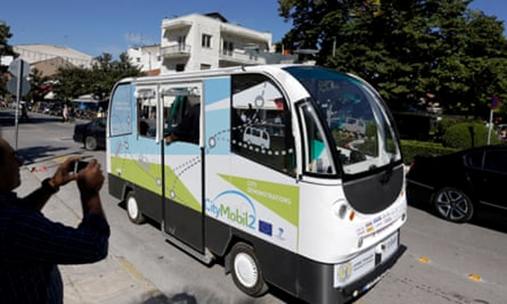
E-trikala
Trikala also collaborates with private companies such as Cisco, SiEBEN, Kafkas, Space Hellas and OTS
The aim is NOT to burden the city’s budget at all.
Construed: 35.000 meters of optical fibers throughout the city
35 spots for free access to the internet
30 electronic signs for the public’s information
5 spots of beacons’ applications

Slide 17
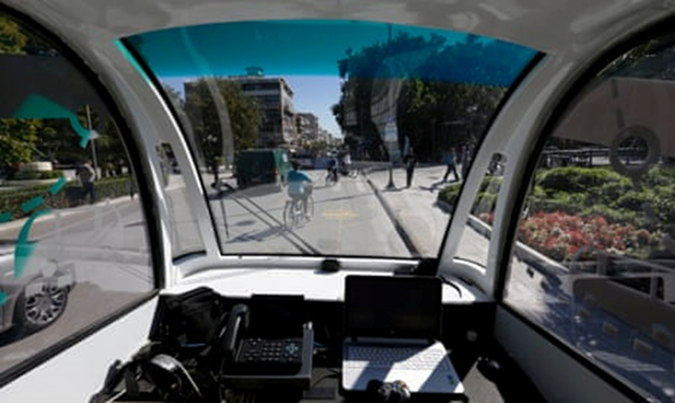
E-trikala

Slide 18
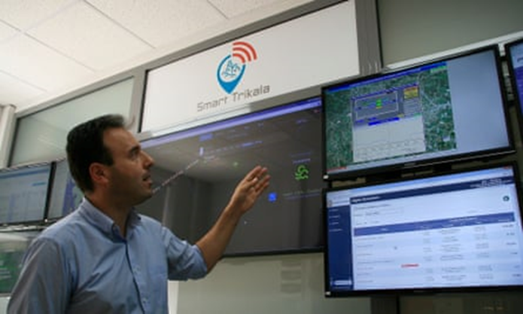
E-trikala
The city’s mayor, Dimitris Papastergiou, inside the control room which monitors everything from parking spaces to the town hall’s monthly budget.
Photograph: Venetia Rainey

Slide 19
Trikala: From the “First Trappaizei” to the flood warning
The city whose name is synonymous with technology and the digital age is that of Trikala. From 2016 until today it has developed a network of digital actions for the benefit of its citizens.
Recent additions to the list of innovations is the deterrent parking system for the 30 disabled places that the city has.
Special sensors “understand” if the vehicle in the demarcated position has a Wireless Parking Identification Card for the disabled – which is provided to the person by the municipality.
If not, then the Municipal Police, which receives the signal, proceeds to remove license plates. According to the people of the Municipality of Trikala, from the time the measure became known, parking spaces for the disabled were decongested by 40%.
The river level control system, with warning in case of impending floods, “premiered” last year during severe weather front “Ianos”.
With three large rivers flowing through Trikala, the operation of such a digital tool was vital, with measuring stations at the sources of the rivers, which send the data to make the necessary moves by the Civil Protection of the municipality.
Meanwhile, during the quarantine last March, an application was “born” that helps the citizens of Trikala to “close” the sports venue they want at a specific date and time.
The “First Trappaizei”, for the 15 sports centers and stadiums of the city, already has 1,700 users, while only for October the reservations reached 550.

Slide 20
HERALKEION SMART CITY
Herakleion started as a digital city in 2007-e-government services
The plan widened with smart city identity
Committee titled ‘Irakleion, Smart City’-Participation of:
The City
the University of Crete
the Technological Educational Institute of Crete
the Institute of Technology and Research of Crete
the Technological Park of Crete and the
Commerce-Industry Chamber of Crete

Slide 21
Smart activities:
E-government/e-democracy-culture, education and tourism applications
Sectors: energy/environment/sustainable mobility and transport/open and smart government and other infrastructure:
Wireless network of the City: connects 180 spots
Metropolitan network of optical fibers=75km one of the largest in Greece
Datacenter/openstack software
Data management=open data/open content/open government/City Big Data applications
Plans for IoT applications also

Slide 22
e-Ηρ@κλειο=web portal of Irakleio
E(applications, complaints, payments, library, index of decisions of public bodies, newsletters, forums.
The meetings of the city councils = live for all to see
Also on demand—also you tube
Social network of the City-connected to the citizens
Offers digitized content of the Vikelea Library of Irakleion (cultural treasures)
Offers digitized copies of the Cretan Gazettes of 1890-1960
Tourist infopoints with interactive systems for visitors and students on the attractions of Iralkeion
Citizens can inform of problems via their mobile/portal/telephone-can watch the progress of the resolution
Participation in CommonFest, Opencoffee, Student digital creation festival, communities of open software, TEDxHeraklion
Many awards for these applications

Slide 23
Thessaloniki Smart City
Plan of a Smart city-sectors of Smart Governance
  Smart Environment
  Smart Mobility
  Smart Economy
  Smart Living
  Smart People

Slide 24
USING: 1 Crowdsourcing and 2. Open Data
Applications
Smart cities and communities partnership
Smart Cities Consortium
Open City Budget at real time
Open Data
e-services / ‘Improve my City’

Slide 25
Apps4Thessaloniki=crowdsourcing platform inviting submissions by the citizens towards the creating of web/mobile applications and the publication of open data
Hackathess=a marathon for developing applications (hackathon)-invitation to programmers and software designers to submit ideas and proposals for smart web applications and mobile phones – economics/networks/social care services/quality of life/government
Apps4Thessaloniki-Tourism-Edition=a contest to activate the city’s potential on new applications for tourism---
Infrastructure for GIS data of the City

Slide 26
STORM Project
«Mayors’ Agreement»: The city of Thessaloniki belongs to the voluntary network of cities aiming at the reduction of CO2 by 20% until 2020
Energy Vision 2020 for South East European Cities: Thessaloniki is part of the network towards the development of policies to reduce energy spending especially in the construction’s sector
PEPESEC Project: reinforcement of the role of local communities/organizations of local government for the development of energy planning
SMART MOBILITY=platform for the management of urban mobility and traffic control
MOBITHESS
EasyTrip Project: services for intraborder accessibility between Greece and Bulgaria via smart phones, web e.tc.
Smart business
Digital commercial center-representation of the market, entering feedback by the business
• thesswiki: digitization of history/culture of the City of Thessaloniki by the citizens via Wikipedia

Slide 27
Smart citizens
Integrated Green Cities: an interactive web game towards teaching young children the methods to manage rainwater in Thessaloniki
«SYNTHESIS»: a platform for the activities, events, communication and networking of teams of active Thessaloniki citizens

Slide 28
Smart citizens
Six Greek cities (Athens, Ioannina, Kalamata, Kozani, Thessaloniki and Trikala) have been selected by the European Commission among 377 cities to participate in the EU Mission for 100 Climate-Neutral and Smart Cities by 2030 in the domains of energy, transportation and urban planning.
The Mission for Climate-Neutral and Smart Cities is a novelty of the Horizon Europe research and innovation program for the years 2021-2027 and it aims to bring concrete solutions to the big challenge of climate change and digital transformation.
The selection of the Greek cities is a great success for the country and it is the result of hard work and cooperation between the 6 cities and the Greek Environment Ministry in the last two years.

Slide 29
Kalamata
Kalamata is a Mediterranean city of the southwestern Peloponnese and the capital of Messinia, being faced occasionally with extreme weather events
To deal with the effects of climate change, local authorities in Kalamata have been implementing national and EU projects of more than 120 million Euros for the last 5 years
Through their participation in these programs, local authorities have gained important knowledge and they have participated in beneficial synergies and networks
The Municipality has prepared its proposal for a climate-neutral and smart city through public consultation with citizens and visitors, scientists, and the business community of the city

Slide 30
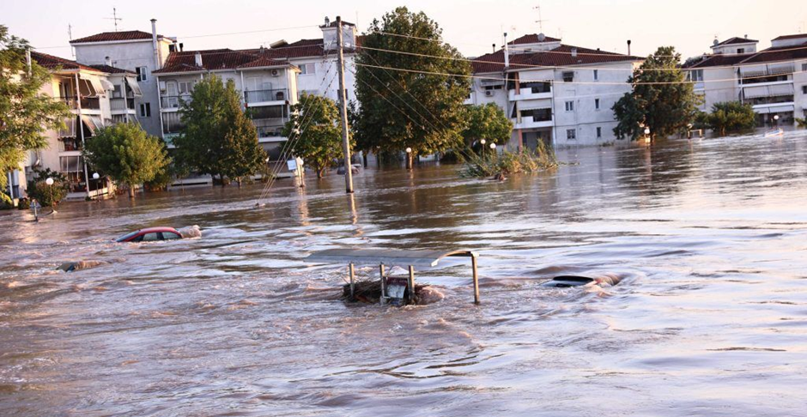

Slide 31
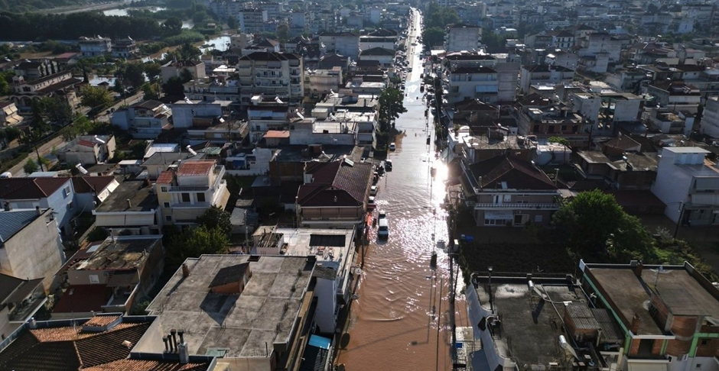

Slide 32
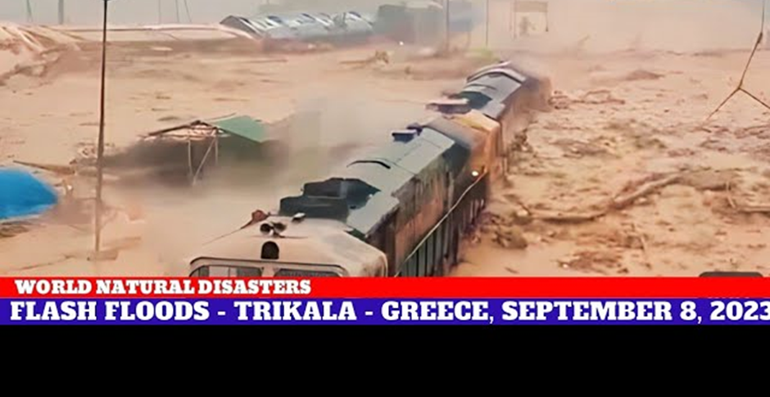

Slide 33
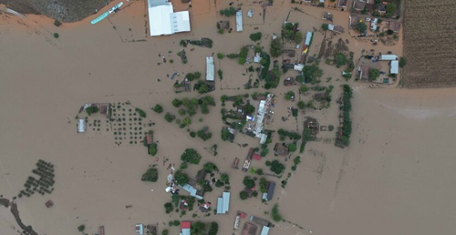

Slide 34
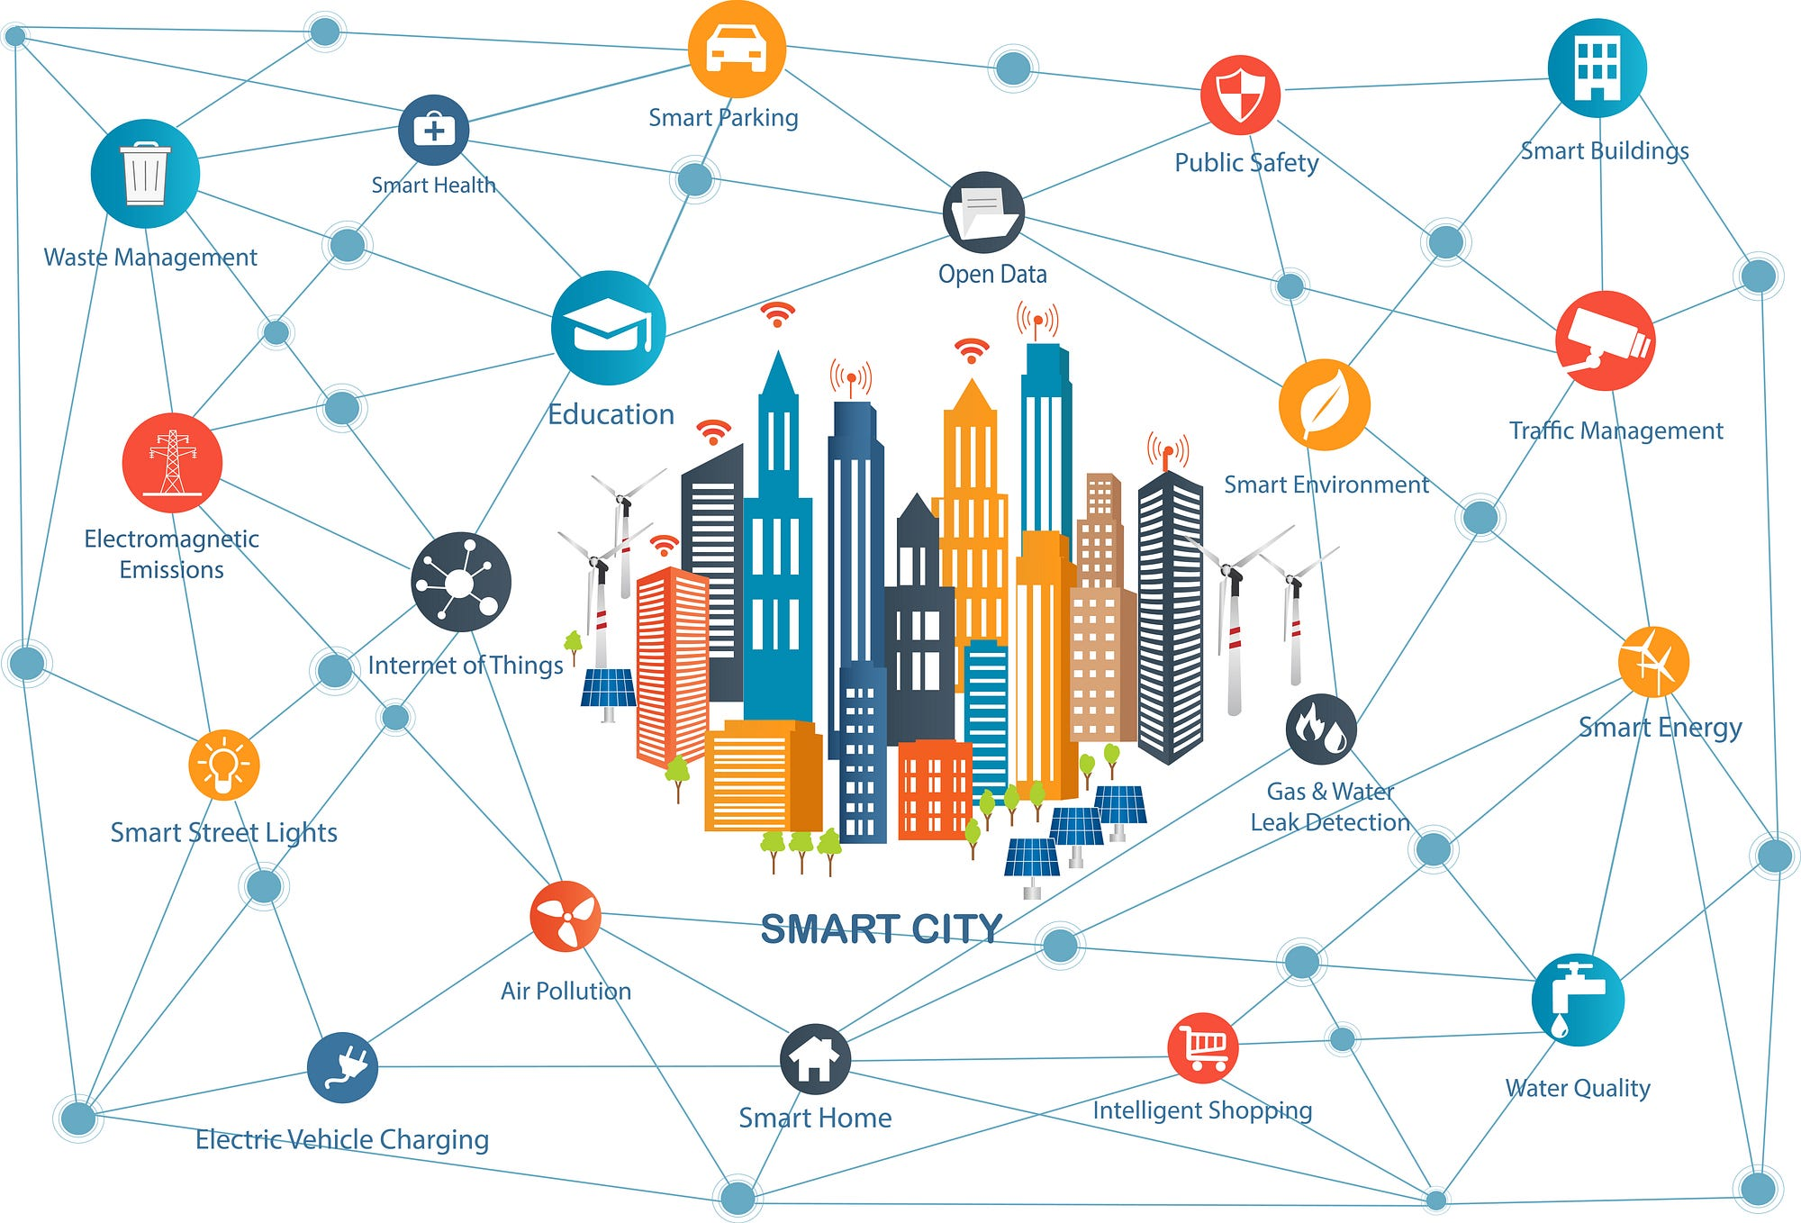
Thank you for your attendance
Αυτή η φωτογραφία από Άγνωστος συντάκτης με άδεια χρήσης CC BY

