Slide 1
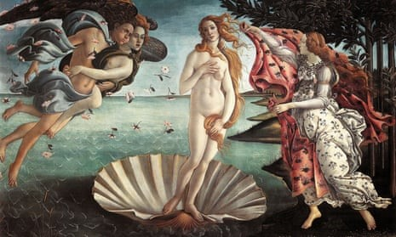
The Boticelli contradiction: Cultural heritage laws as threats to…cultural heritage
Workshop-Threats to Cultural Heritage:
Normative and ethical approaches and contradictions
Maria Bottis, Professor,
DALMS, Ionian University
UNESCO CHAIR IU-GEOLAB March 15, 2023

Slide 2
Once upon a time…

Slide 3
Primavera
There was Boticelli
A great painter in Early Renaissance Italy, born 1445 died 1510
He gave humanity some of the best paintings such as:
The birth of Venus

Slide 4
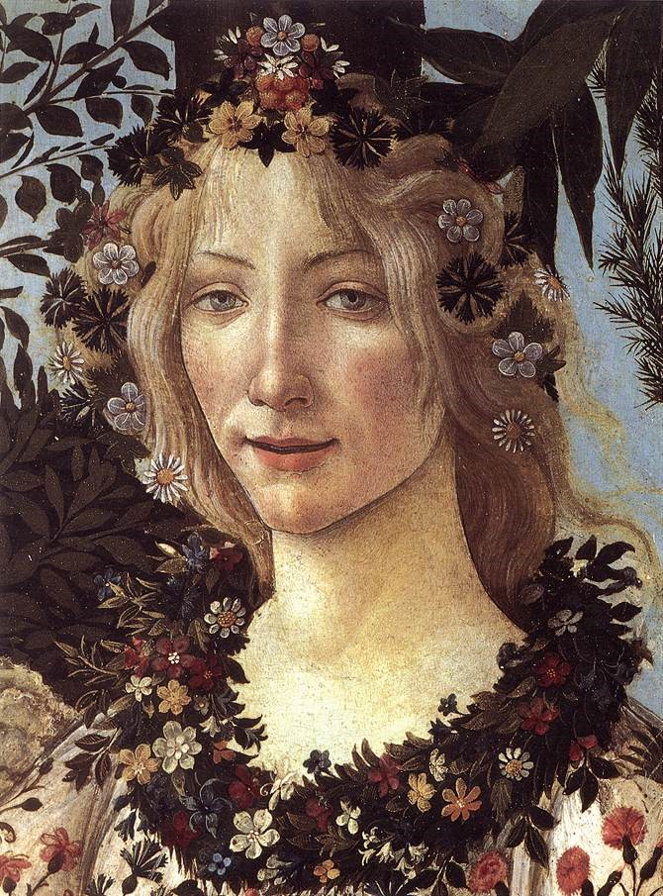
The Adoration of the Magi

Slide 5
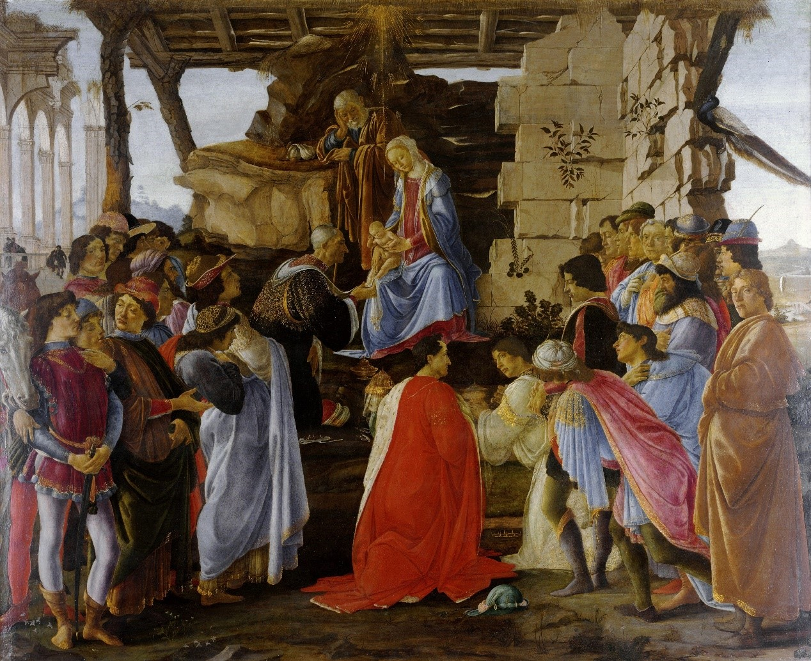
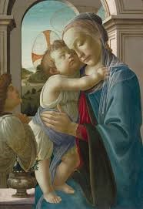
Virgin and child with an angel

Slide 6
And so many others… real treasures of cultural property well beyond the Italian one…
Who doesn’t know the birth of Venus?
How do we all know it?
Have we all visited the Uffici gallery?
From reproductions in books---in school---in later art…in Wikipedia…in galleries’ sites…in the internet…

Slide 7
From a copyright point of view:
There is no protection for these reproductions. (Or is there?)
Copyright lasts for 70 years after the author’s death.
Copyright in this sense for Boticelli’s works would have ended in 1580, since he died in 1510.
But at that time, no copyright laws existed.
And of course, no laws on the protection of cultural property.

Slide 8
So we could say that today…..
Boticelli’s paintings are public domain.
Public domain means that the reproduction of the work for any purpose is free.
Free to all for common use…
Now Europe hasn’t been very explicit in its legislation on what the public domain is.
We have Directives on copyrights since 1991 (251/199/EEC-software, and many others).
But the term public domain makes its presence as late as in 2019, with the 790/2019 Directive on copyright in the Digital Single Market.

Slide 9
So we could say that today…..
Works of visual art in the public domain = the faithful reproduction of works of visual art in the public domain is free.
Article 14: only original reproduction of the work (author’s own intellectual creation) is protected.
So a photo = material from a faithful reproduction of a work in the public domain = free.
No license. No remuneration. For any purpose. Free.

Slide 10
Why?
Because we care about a rich public domain. For education, enlightenment, enjoyment, and of course, the dissemination of culture.
As wider a dissemination of culture as possible.
Enter = cultural property laws
In many countries (example Greece/Italy e.tc.) we have strict cultural property protection laws.
These laws usually protect the physical embodiment of cultural property (although immaterial cultural property is also protected in the sense of documentation e.tc.).

Slide 11
Ηow?
The main protection concerns the preservation of the physical, the material where cultural property is embodied.
No destruction, no alteration, no alienation, no export, no theft e.tc.
But there are some laws, also, dealing with the reproduction of an object of cultural property.
Some laws reserve the right to reproduction to particular bodies, such as, in Greece, the Organization of Management of Cultural Property (OΔΑΔ).
And according to Italian law, any use of the country’s publicly owned art to sell merchandise requires permission and payment of a fee.
Αnd we also see in Museums’ Charters terms that they only have the right to the copies of the works in their collections. Irrespective of the time when these works were created. Irrespective of the purpose (commercial or not) of the reproduction sought. Irrespective of what the public domain IS.

Slide 12
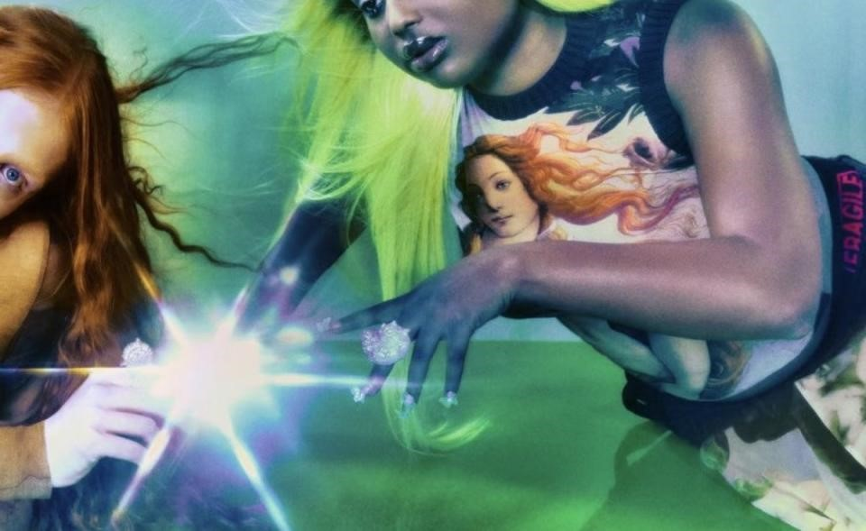
A lawsuit
The Gallery Uffici in Italy SUED Jean Paul Gaultier because the fashion house designed and sold clothes inspired by the Birth of Venus.

Slide 13
The legal basis
The Uffizi Gallery in Florence is not pleased with Jean Paul Gaultier's "Le Musée" capsule collection, a range of apparel printed with famous Renaissance paintings.
The museum is suing the brand for its "unauthorized use" of Sandro Botticelli's "The Birth of Venus," currently housed at the institution.
Snippets of the work appear on a tank tops, pants, skirts, scarfs and dresses — commercial usage that, according to Uffizi, violates Italy's Cultural Heritage Code.

Slide 14
The claim
Uffici asks for 100.000 euros to license the use of the image of the Boticelli Venus to Gaultier.
Especially after the Directive = the rule makes no sense.
The rule encloses any image which is public domain and seeks to license it—in the sake of cultural heritage protection.

Slide 15
But why is cultural heritage (this Botticelli painting) protected when Gaultier pays Uffici and unprotected when Gaultier doesn’t pay?
The lawsuit aims at SHARING Gaultier’s profits from its sales with the Museum.
The lawsuit does NOT claim that the USE of the reproduction HARMS cultural property (the original). That it HARMS the MORAL RIGHT of Boticelli to his work.
(Venus ridiculed…objects insulting the painter and his work).
Conceptually = the harm is that we take Venus OFF public domain = we make public domain POORER.

Slide 16
Wide dissemination
Do we want / should we want the widest possible dissemination of Venus to the public?
The widest possible use?
Would this dissemination not help the public learn who Boticelli was, what are his works, and enjoy them more?

Slide 17
Wrong use of rules
The very rule blocking access to Venus in the name of the protection of cultural property is a rule which unprotects it…empoverishes it…harms it…
This is what I call the Boticelli contradiction.
How must we resolve the Boticelli contradiction?
Insist that cultural heritage laws do not apply when they clash with copyright rules that free reproductions of unprotected by copyright rules to the public domain

Slide 18
Copyright interpretation
Insist that copyright laws COVER the so called ‘ancient’ works.
Insist that no COPYFRAUD will be allowed
What is copyfraud?
A museum claiming it has absolute rights to reproductions of works in its collection when this is false
The State insisting on the same absolute right, coming from wrong cultural property laws.
The Greek statute=unfortunately incorporated the Directive art 14 wrongly

Slide 19
Free the works
Adding a paragraph that cultural property protection law is valid, against art. 14, as a SPECIAL rule-(special laws have priority over general laws)
BUT the class of all ‘monuments of cultural property’ is NOT A SPECIAL (‘smaller’) CLASS in relation of the class of ‘WORKS OF VISUAL ART THAT HAVE FALLEN INTO THE PUBIC DOMAIN’.
It is impossible to sustain this specialty here…it is illogical.
We need to abolish this section from the law-And FREE cultural property to all.

Slide 20
THANK YOU

